Slide 1
Unit 1
Can you play the guitar?
Section B 3a-Self Check
七年级(下)

Slide 2
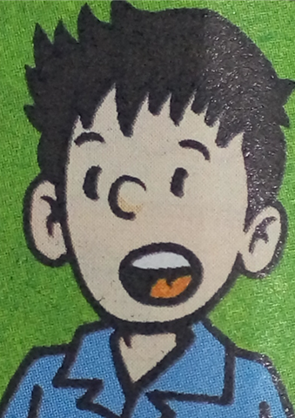
3a
Complete the ad with the words in the box.
Musicians Wanted for School Music Festival
guitar
can
call
dance
music
play
Do you like ?
Can you sing and ?
Can you the piano or the violin?
Can you play the or the drums?
Then you be in our school music
festival.
Please Mr. Zhang at 622-6033.
music
dance
play
guitar
can
call

Slide 3

3b
Make a poster. Ask for help with an
event at your school.
You can use:
sports players(运动员)
school sports day(学校体育活动日)
play soccer/basketball/ping-pong/tennis
swim
run fast(跑的很快)
Please call…at…

Slide 4
Writing：Make a poster
Every May, there is an English talent show for the students from Grade 7 in our school. We have had kinds of performances (表演) in English before.They are amazing. It is your
turn to take part in the show this year.
请你为今年的英语才艺展示写份招募学生的海报。

Slide 5
Students Wanted for the 6th School
English Talent Show
学校第六届英语才艺展示招生
______________________________________________________________________________________________________________________________________________________________________________________________________________________________________
______________________________________
We want students for the 6th School English
Talent Show. Can you speak English well? Can
you sing English songs? Can you tell stories or
write stories in English? Can you act? If you
can, please write to your English teacher.
Come and join us!

Slide 6
Summary How to make a poster?
1. title 标题
Students Wanted for the 6th School English Talent Show
学校第六届英语才艺展示招生
2. who and for what 对象和目的
We want students for the 6th School English
Talent Show.
3. abilities required 能力要求
Can you speak English well? Can you sing
English songs? Can you tell stories or write stories in
English? Can you act? If you can, please write
to your English teacher.
4. Contact information 联络信息
* time and place 时间与地点

Slide 7

Make sentences with the phrases.
be good with
_____________________________
2. make friends
_____________________________
3. help sb. with sth.
_____________________________
I’m good with old people.
Do you like to make friends?
I want to help him with his sports.

Slide 8
4. on the weekend
__________________________________
5. also
__________________________________
6. call … at …
__________________________________
7. play the piano
__________________________________
Let’s play chess on the weekend.
His sister can also play the drums well.
Please call Mr Bush at 347-9621.
Can your sister play the piano?

Slide 9

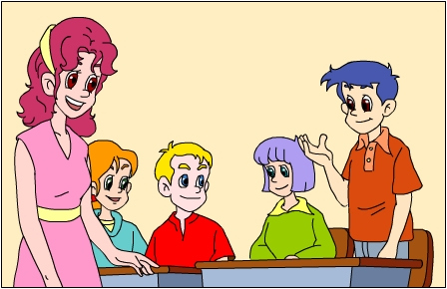
Tell something about yourself.
My name’s Jack. I like to play sports. I can play soccer. I can play volleyball. I can play basketball. I can play tennis. I can play ping-pong.
I like music. I can play the guitar. I can play the violin. I can play the piano. I can play the drums.
It’s your turn now.

Slide 10



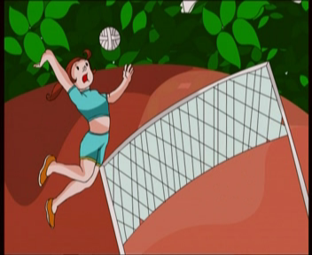
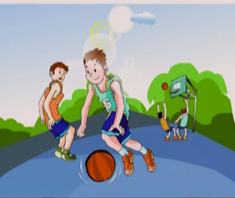
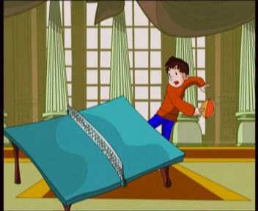

Guess what he/she can do.
Lin Tao is good at sports. What can he do? Can you guess?
He can play basketball. He can …
swim, play ping-pong, play tennis, play soccer and play volleyball.

Slide 11





Jenny is good at languages. What can she speak? Can you guess?
She can speak …
English, Chinese, Japanese and French.

Slide 12


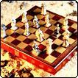





She can sing. She can …
Linda is good at music and arts. What can she do? Can you guess?
draw, dance, play the guitar, play the violin, play the piano and play the drums.

Slide 13

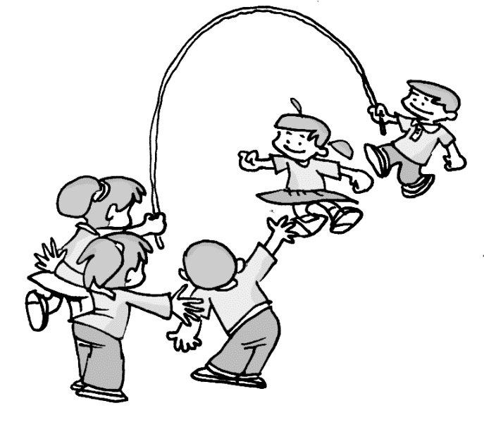
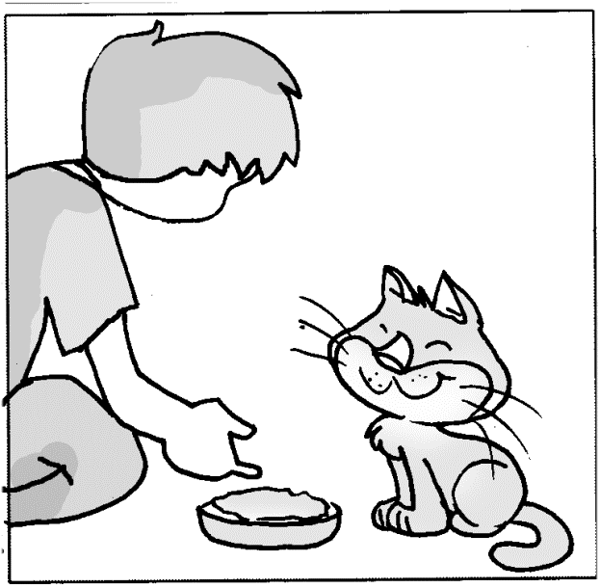

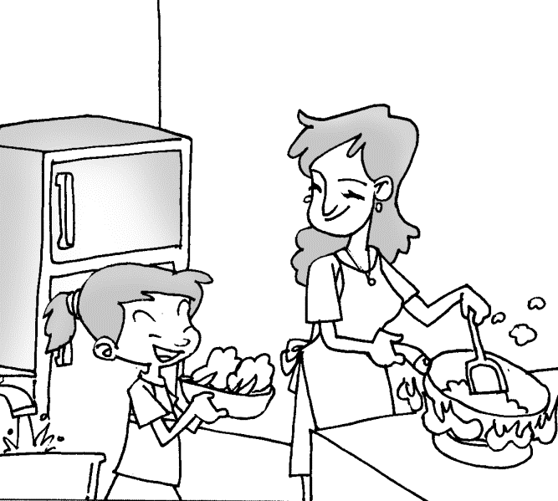
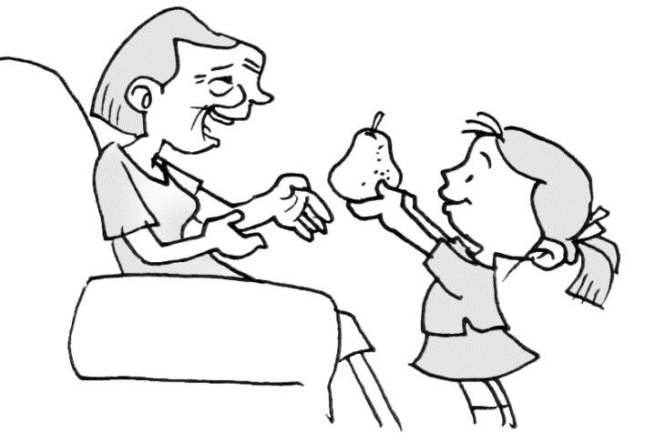


Grace is good at many things.
What can she do? Can you guess?
从前，在森林里有一个……
She can …
help with old people, help with mom, tell stories, help with the cat, help with math, help with sports.

Slide 14

Read the conversation
A: Hi, can I help you?
B: Yes, please. I want to join the art club.
A: Good. May I know your name?
B: Jones.
A: What’s your first name?
B: Cindy.
A: How old are you?
B: Twelve.

Slide 15
A: Can you draw?
B: Yes, a little. I want to learn about art.
A: Do you have an e-mail address?
B: Yes, it’s cindyj@pep.com.cn.
A: Great. I will contact you later.
B: Thank you.

Slide 16

Fill in the card
Name:___________
Age: ___________
E-mail address:____________________
What can you do?
______________________________
Why do you want to join the club?
______________________________
Cindy Jones
twelve
cindyj@pep.com.cn
I can draw little.
I want to learn about art.

Slide 17
Self-Check
1 Add more words and phrases in each box.
Abilities
Music and
arts
Other
abilities
Languages
Sports
play the
violin
English
swim
tell stories

Slide 18


Add as many words as you can to make
phrases.
1. play the drums, _________________
2. speak English, _________________
3. help with math, _________________
4. be good at telling stories, _______
5. be good with old people, ________

Slide 19

3 What can you do? What can’t you do? What about the people you know? Write at least five sentences.
— Can you …?
— Yes, I can./ No, I can’t.
names | I | mom | dad | sister
Can you play the guitar?
Can you sing?
Can you dance?
Can you draw?
Can you speak English?
…

Slide 20
Then try to make a report to your class.
Report:
Hello, everyone, I’m …, I can …, but I can’t … My mom can …, but she can’t … My dad can …, but he can’t … My sister can …, but she can’t …

Slide 21
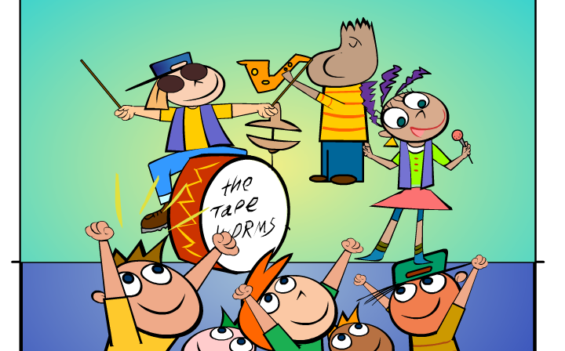
Just for Fun!

Slide 22

Make a poster. Ask for help with an event at your school.
你们学校的体育俱乐部招聘一位体育老师来帮助学生练习体育运动。请你来写一个招聘广告。要求：
擅长与孩子们交往。
会多种体育项目。
打337-6013联系吴老师。
P.E. Teacher Wanted for the School Sports Club ________________________________
_____________________________________.

Slide 23
写作指导
根据前面学过的招聘信息，我们可以用一般疑问句提出要求，让应聘者了解信息。
根据提示信息，可知应聘者应喜欢孩子，热爱体育，会多种体育项目。
最后 ，说明学校联系方式。

Slide 24
One possible version:
P.E. Teacher Wanted for the School Sports Club
Do you like sports? Are you good with children? We need to help with sports in the sports club in our school. Can you swim? Can you play volleyball or tennis? Can you play basketball or soccer? Then you can be a P.E. teacher in our school. Please call Mr Wu at 337-6013.

Slide 25

一、根据实际情况回答。
Yes, I do.
1. Do you like to make friends? __________
2. Can you play the piano? ______________
3. Can your dad play the violin? ___________
4. What can your mom do?
______________________
5. Are you free this weekend? __________
No, I can’t.
Yes, he can.
She can play the drums.
Yes, I am.

Slide 26
二、写出句子。注意标点和大写字母。
1. chess, to, you, like, play, do (?)
__________________________________
2. you, can, the, play, piano (?)
__________________________________
3. you, club, our, be, music, in, can, then (.)
_________________________________
Do you like to play chess?
Can you play the piano?
Then you can be in our music club.

Slide 27
4. is, old, good, Linda, people, with (?)
_________________________________
5. help, can, with, your, and, music,
English, I (.)
__________________________________
6. tell, his, draw, can’t, or, stories, brother (.)
_________________________________
Is Linda good with old people?
I can help with your English and music.
His brother can’t draw or tell stories.

Slide 28
三、选词补全招聘广告。

Help for kids (儿童)
Are you good _____ kids?
Do you like to ____ games with kids?
Do you like music? Do you like ______?
Can you draw ___ play chess?
Can you sing or _______?
Can you tell _______?
Please come to the Children’s _______.
____ Ms Black at 578-3210.
or, sports, with, Call, stories, play, dance, Center
with
play
sports
or
dance
stories
Center
Call

Slide 29
四．根据句意及词首字母写出单词。
1. Gina wants to j____ the music club.
2. Can you s_____ English?
3. I can play the guitar but can’t play the
p_____.
4. My e-mail a_______ is cindyyjones
@ 163. com．
5. Can you h____ kids with swimming?
oin
peak
iano
ddress
elp

Slide 30
五.单项选择
1. Tom wants ________ to you. Are you free?
A. to tell B. tells C. to talk D. talks
2. Can you help me ________ my English?
A. with B. of C. learning D. about
3. Here ________.
A. is some informations
B. are some informations
C. are some information
D. is some information
C
A
D

Slide 31
4. Bob can play _____ tennis but
can’t play _____ violin.
A. the, the B.×, ×
C. the, × D. × , the
5. Can you paint? ________.
A. Yes, a little B. Yes, little
C. No, a little D. No, little
6. Please call me _______ 8989766.
A. in B. at C. about D. with
D
A
B

Slide 32
7. ____ like to go swimming _____summer.
A. Children, on B. Children, in
C. A child, on D. A child, in
8. Miss Read is good ______ music. She can
be good ____ children in the music club.
A. at, at B. with, with C. at, with D. with, at
9. The young _____ plays the ____ very well.
A. pianist, piano B. piano, pianist
C. pianist, pianist D. piano, piano
B
C
A

Slide 33
10. --What can you do, Lin Tao?
-- ________.
A. I like sports B. I am well
C. I want to join the music club
D. I can do Chinese kung fu
11. -- Hi, can I help you?
-- ________.
A.Yes, please B. No, I can’t
C. Yes, I can D.You are welcome
12. ______ you can _____ our school concert.
A. Maybe, in B. Maybe, be in
C. May be, in D. May be, be in
D
A
B

Slide 34
六.将下列句子译成英语
1.我想当一名艺术家。
2.我想加入艺术俱乐部。
I want to be an artist.
I want to join the art club.

Slide 35
3.琳达很会唱歌。
4.请向张老师咨询更多的信息。
Linda can sing well.
/Linda is good at singing.
Please ask Mr Zhang for
more information.

Slide 36

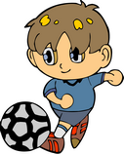


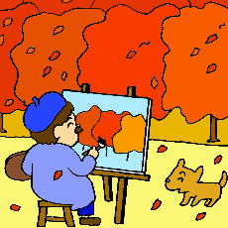



Chain work A: Can you ……?
B: Yes, I can. / No, I can’t. Can you ….
C: Yes , I can. / No, I can’t. Can you …
swim
speak English
sing
play soccer
paint
play chess
dance
play the guitar

Slide 37

You are great !
You can do many things.

Slide 38
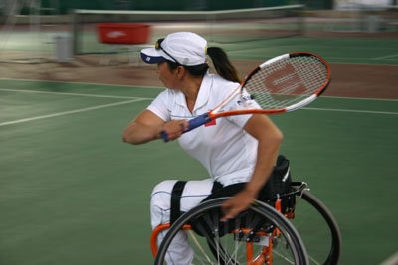
S: Can she…?
T: Yes, she can.
/No ,she can’t.
She can’t walk(走),
but she _______________.
can play tennis

Slide 39
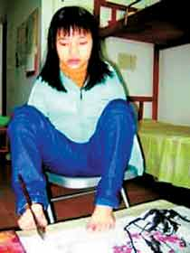
S: Can she…?
T: Yes, she can.
/No, she can’t.
She doesn’t have arms (手臂),
but she _________ with her foot (脚).
can paint

Slide 40
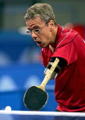
S: Can he…?
T: Yes, he can.
/No, he can’t.
He doesn’t have arms,
but he __________________.
can play ping-pong

Slide 41
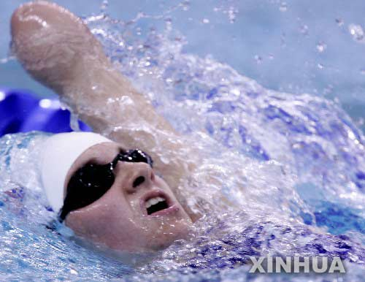
S: Can he…?
T: Yes, he can.
/No, he can’t.
He doesn’t have arms,
but he __________.
can swim

Slide 42
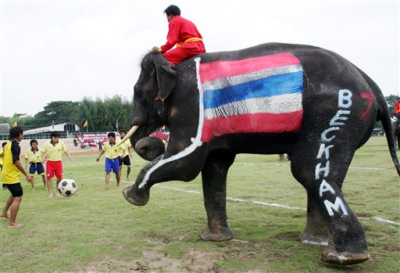
S: Can it…?
T: Yes, it can.
/No, it can’t.
It is very big. But it _______________.
can play football

Slide 43
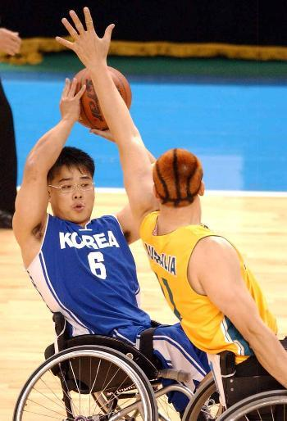
S: Can they…?
T: Yes, they can.
/No, they can’t.
can’t
They _______ stand up(站立),
but they ___________________.
can play basketball

Slide 44
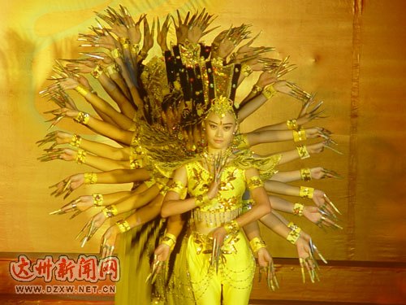
They _____ hear(听到) the music,
but they ___________ very well.
can’t
can dance

Slide 45

Where there is a will, there is a way.

Slide 46
Homework
你对你的家人了解吗? 他们能做什么?
不能做什么？请对他们做一个采访,
看看你能为他们做些什么。

Slide 47
Thank You!

